Slide 1
ABC Wireless Inc-Churn
Group-5

Slide 2
Problem Summary
Customers in the telecom industry move from one carrier to other for various reasons.
When a customer leaves, the company not only loses the future revenue from that customer but also the resources spend to acquire that customer.
This makes Churn one of the major problems in the telecom industry.

Slide 3
Strategies used by companies to stop Churn
Untargeted approach: the company does mass advertising to increase brand loyalty and thus retain customers.
Targeted approach: companies try to identify customers who are most likely to churn. Once they are identified companies then try to stop them from moving to other carriers by strategic marketing and by providing better deals
Project Goal: The goal of the project is to build a model that can predict customers who are likely to churn using historical data of ACB Wireless Inc.

Slide 4
Overview of the data
ABC Wireless Inc has provided data of 3333 customers
Data has 19 predictors of churn.
We need to build a predictive model using this data.

Slide 5
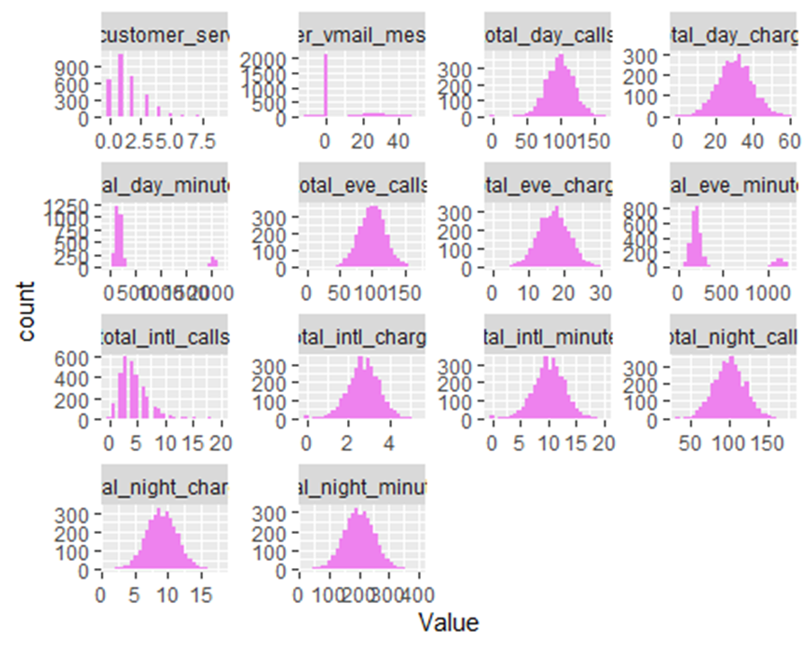
Dispersion and Skewness of the data
Most of the data is symmetrically distributed. The number of customer service calls has an irregular skewness. Total day minutes and Total evening minutes have a significant amount of outliers.

Slide 6
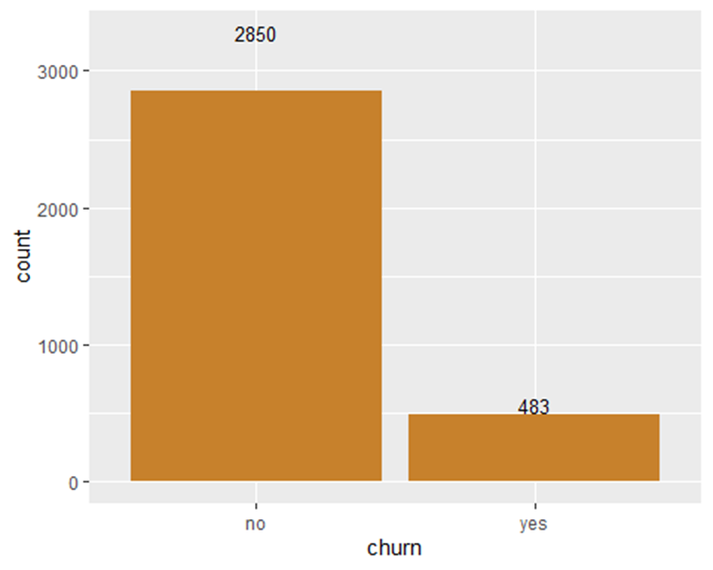
Churn in the data

Slide 7
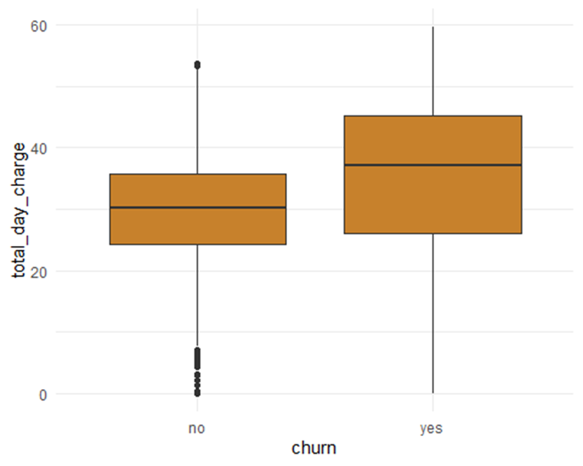
Churn against total day charges
The midpoint of the box plot in the case of churn is yes is slightly higher than that of no churn. This means that the customers who are paying a total day charge of more than 30 are more likely to churn.

Slide 8
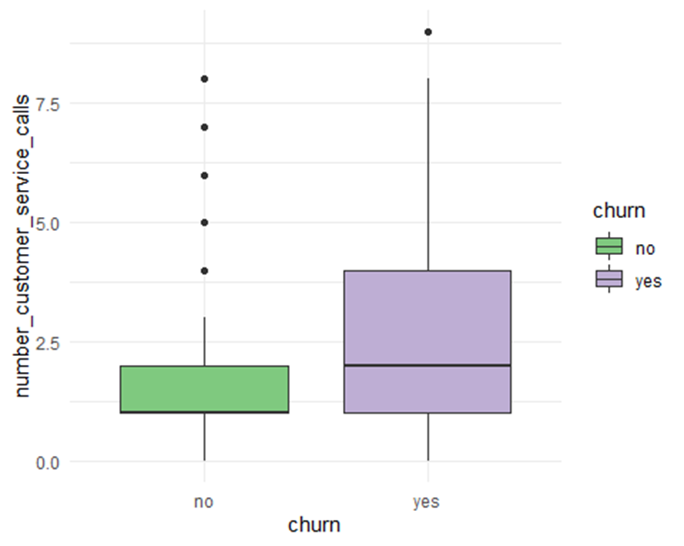
Churn rate based on Customer service calls
Customers who have called customer service more than 2-3 times are more likely to churn. About 76% of customers who called customer service more than once have churned.

Slide 9
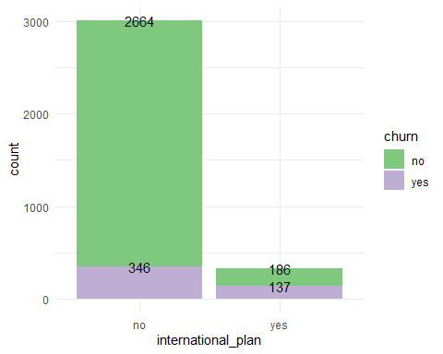
Relation between Churn rate and international plan
42% of customers with the international plan are likely to churn

Slide 10
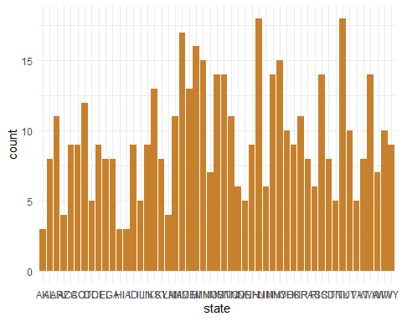
Churn per State
The States of Maryland, New Jersey, Michigan, and Texas have high churn rates.

Slide 11
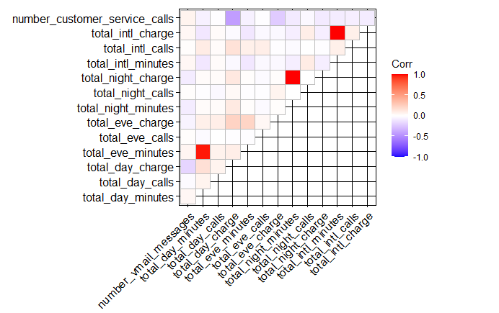
Correlation between the variables when churn is yes

Slide 12
Predictive modelling
Predictive Modeling can be done based on Regression and Decision Tree Models.
Regression modeling can be done in two ways:
1. Linear Regression
2. Logistic Regression
For the present project on ABC Wireless Inc Logistic regression is more appropriate compared to linear regression as the dependent variable is categorical.

Slide 13
Comparing Both the models performance
Logistic Regression Model
1. Accuracy: 87.58%
2. Sensitivity: 98.13%
3. Specificity: 25%
Decision Tree Model
1. Accuracy: 91.58%
2. Sensitivity: 96.49%
3. Specificity: 62.5%

Slide 14
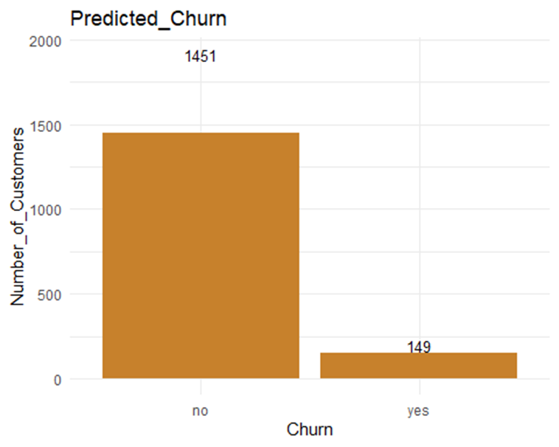
Final predictions of Decision Tree Model

Slide 15
Suggestions and Recommendations:
ABC Wireless Inc should try to target those 149 customers as they is a high chance to churn. The Company needs to do strategic marketing to those customers to improve their brand loyalty of those customers.
Overall company needs to take the following steps in order to reduce the churn rate:
1. Try to reduce the Total day charge.
2. Company needs to improve customer satisfaction as low customer satisfaction leads to customer service calls and it is directly related to churn.
3. Company needs to provide better deals for customers with an international plan.
4. Company needs to come up with better marketing strategies for Maryland, New Jersey, Michigan, and Texas States.

Slide 16
THANKYOU

